Slide 1
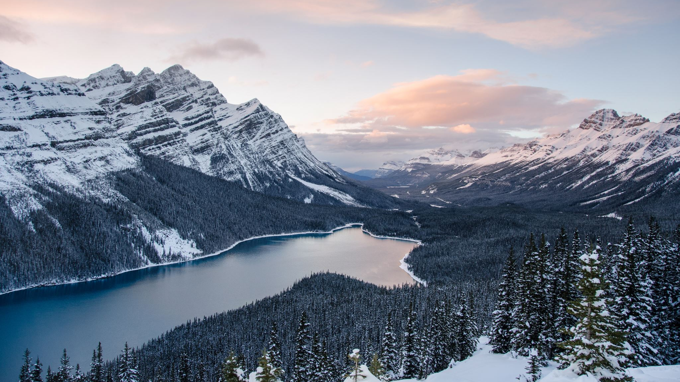
Hope and Combating Climate Change
How are these connected?

Slide 2
Outline
Why am I doing this presentation? & Goals of this presentation
What is hope?
Why is hope important for combating climate change?
Actions we can take to combat climate change
Organizations inspiring climate action and a hopeful narrative
Conclusion

Slide 3
Why am I doing this presentation?
Goals of this presentation:
1. Inspire you to take action against climate change. Inspire hope for the future.
2. Inspire hope for the future.
Climate change is happening
There is a lack of information given on what individuals can do to combat climate change
  This creates a sense of helplessness and a lack of hope.
I want commit to educating others on climate change and what they can do to take action.
I also want to teach people importance of hope for overcoming challenges resulting from climate change
I will achieve these goals by:
1. Educating you on the importance of hope.
2. Providing you with different ways to combat climate change.
3. Sharing different organizations that spread a more hopeful message.

Slide 4

What is Hope?
Hope requires:
  Motivation and the ability to make something happen
  Plans and strategies to pursue the goals
Hope vs. Wishing
  Hope is active and wishing is passive.
Hope Theory:
  Why?: It assumes suffering and a need for change
  What?: A sense of purpose / meaning (What do we hope for?
  When?: Imagining a possible future
  Who?: A community of people with common values and sense of purpose
  How?: Goals, Pathways, and Agency
  Where?: The possibility of hope exists within every person, discipline, place, and situation

Slide 5
Why is hope important for combating climate change?
Studies done by the American Psychological Association show that climate change can negatively affect our mental health:
  It can trigger stress, depression, and PTSD, strains our personal and community relationships, and leads to increases in aggression, crime, and violence
Made worse by easy access to news, social media, etc. - “If it bleeds, it leads”
  Profit motives may lead to shocking narratives (often negative) in the media.
  In the long term, readers are desensitized, disempowered, and disengaged.
Hope helps us stay engaged with stressful situations, and promotes coping skills

Slide 6
“What can we do to help combat climate change?”
How we travel?
What we eat?
What we buy?
How we use energy?

Slide 7
Actions we can take to combat climate change:
Save energy at home
  Reduce heating and cooling, switch to LED light bulbs and energy-efficient appliances, wash your laundry with cold water, or hang things to dry.
Walk, bike, or take public transport
  Walk or ride a bike, take a train or bus, and carpool.
Eat more vegetables
  Producing plant-based foods is generally more environmentally friendly that producing meat and dairy.
Reduce, reuse, repair, recycle
  Rent, borrow and buy used.
  When buying new, choose high-quality, durable goods that will last.
Change your home's source of energy
  Install solar panels on your roof to generate energy for your home.
Switch to an electric vehicle
  Reduces air pollution.
  EVs produce significantly fewer greenhouse gas emissions than gas or diesel-powered vehicles.

Slide 8


Actions we can take to combat climate change: (cont.)
Consider your travel
  Avoid flying as planes produce significant greenhouse gas emissions.
Throw away less food
  Throwing away food means wasting the resources and energy that were used to grow, produce, package, and transport it.
  Rotting foods in landfills produce methane.
Choose eco-friendly products
  Buy local and seasonal foods.
  Choose products from companies who use resources responsibly and are committed to cutting their gas emissions and waste.
Speak up and educate others
  Speak up and get others to join in taking action.
  Talk to your neighbors, colleagues, friends, and family. Appeal to governments to act now.

Slide 9
Organizations inspiring climate action and a hopeful narrative:
To name a few…
Regeneration
  https://regeneration.org/nexus
United Nations ActNow Campaign
  https://www.un.org/actnow
Aworld App
Lillooet Regional Invasive Species Society
  https://lriss.ca/
Lillooet Naturalist Society
  https://www.lillooetnaturalistsociety.org/
Blueland
  https://www.blueland.com/
David Suzuki Foundation
  https://davidsuzuki.org/what-you-can-do/top-10-ways-can-stop-climate-change/
4Ocean
  https://www.4ocean.com/
Coral Restoration Foundation
  https://www.coralrestoration.org/
Net Zero Co.
  https://www.netzerocompany.com/

Slide 10
Conclusion
Why am I doing this presentation? & Goals of this presentation
  Climate change is happening
  A lack of information on what individuals can do to combat climate change creates a sense of helplessness and a lack of hope.
  I want commit to educating others on climate change and what they can do to take action.
  I also want to teach people importance of hope.
What is hope?
  Hope is active and requires:
    Motivation and the ability to make something happen
    Plans and strategies to pursue the goals
Why is hope important for combating climate change?
  Hope helps us stay engaged with stressful situations, and promotes coping skills
Actions we can take to combat climate change
Organizations inspiring climate action and a hopeful narrative

Slide 11
Questions?
Thank you for watching

